Slide 1
MAINTENANCE MANAGEMENT
By
M.WASIM RAJA

Slide 2
MAINTENANCE
The basic principle of maintenance is to extend the useful life of an asset
A proper Maintenance will improve the production with the existing capacity utilization
Maintenance keeps our entire system to be reliable, productive and efficient.
No definite maintenance procedure for a particular plant/ machine; it varies from one plant/machine to others

Slide 3
OBJECTIVES OF MAINTENANCE
To minimize the breakage and maximize the plant availability
To extend the useful life of assets by minimizing wear & tear and deterioration
To ensure the operational readiness of all equipment.
To ensure the safety of workers.
To establish a satisfactory working condition

Slide 4
TYPES OF EQUIPMENT MAINTENANCE
Scheduled Maintenance
Preventive Maintenance
Prediction Maintenance
Restoration Maintenance/Break down/Emergency
Contract Maintenance

Slide 5
PLANNED MAINTENANCE
Scheduled Maintenance:
This type of maintenance is done to avoid break down.
A schedule is framed for an instrument or machine. According to that all works like inspection , lubrication, repair done.
Predictive Maintenance:
Predictive maintenance is to recognize the cause of any change of physical condition of a system. In this method, using instruments like vibrations analyzer, axial displacement monitors, optical devices, non-contacting sensor etc follows sensing, measuring and monitoring techniques.
The main advantages of this system are to inspect the troubles of internal parts without disassembly.

Slide 6
Preventive Maintenance:
Preventive Maintenance is naturally carried out before any interruption of production and major breakdown.
This maintenance is carried out in predetermined intervals.
Preventive Maintenance will out only prevent the breakdown, but also it will improve the output, Quality of product, and contain of the machine.
This preventive Maintenance most successful one and it is adopted in much organization.
The best way to perform preventive maintenance consistently is to develop operational checklists.

Slide 7
Advantages of Preventive maintenance
Major repairs can be avoided.
Gives less production down time.
Product rejection is minimum.
Provide better quality control facilities.
Lengthen the life of equipment.
Provides safety to the workers
Minimum inventory control

Slide 8
Unplanned Maintenance
Restoration Maintenance:
Restoration maintenance, also called repair and corrective maintenance, is the most common maintenance performed.
Restoration maintenance consists of repairing a broken or damaged piece of equipment to restore necessary operation conditions.
Restoration maintenance is basically a fix-it-when-it breaks function, where it leads to equipment downtime, loss of money & manpower.
The Breakdown maintenance does not provide any guarantee of reliability to the smooth production running.
It is better to avoid breakdown maintenance and go for planned maintenance

Slide 9
Contract Maintenance:
Normally it is adopted by small companies by the way of AMC (Annual Maintenance Contract) by using outside manpower, tolls and consultancy
This maintenance is very expensive & time consuming but it leads to hassle free work/production and you may able to concentrate on your core work.

Slide 10
Advantages of Contract Maintenance
Capital expenditures towards maintenance are reduced.
No need to train or retain any workers.
Control over the result.
Disadvantages of Contract Maintenance
Possibility of a long delay in specialty arrival.
More Expensive than integral maintenance.
Problem with union, due to outside person service.
Dependency upon the contracting company.

Slide 11
FUNCTIONS OF PREVENTIVE MAINTENANCE
Planning
Scheduling
Dispatching
Recording
Analysis
Controlling

Slide 12
PLANNING
Planning means formulation of word in advance.
A successful maintenance depends on maintenance planning only.
So “What should be done” and “Where should be done” are the major criteria of successful maintenance.
Maintenance planning may be effectively performed, if the past data regarding inspecting etc, are available in the department.
The best way is to have a “History card” for each machine or instrument. Analysis of the past data can only enable the management build a confident work-planning structure
In case of a preventive maintenance, the total planning should be reflected in Master card

Slide 13
After preparing “Master maintenance schedule”, weekly schedule may also be planned.
But while planning, the activities required for an effective maintenance are to identify. For example: cleaning, lubrication etc

Slide 14
SCHEDULING
A maintenance schedule generally include activities,
Inspection
Repair (Major/minor repair)
Overhauling

Slide 15
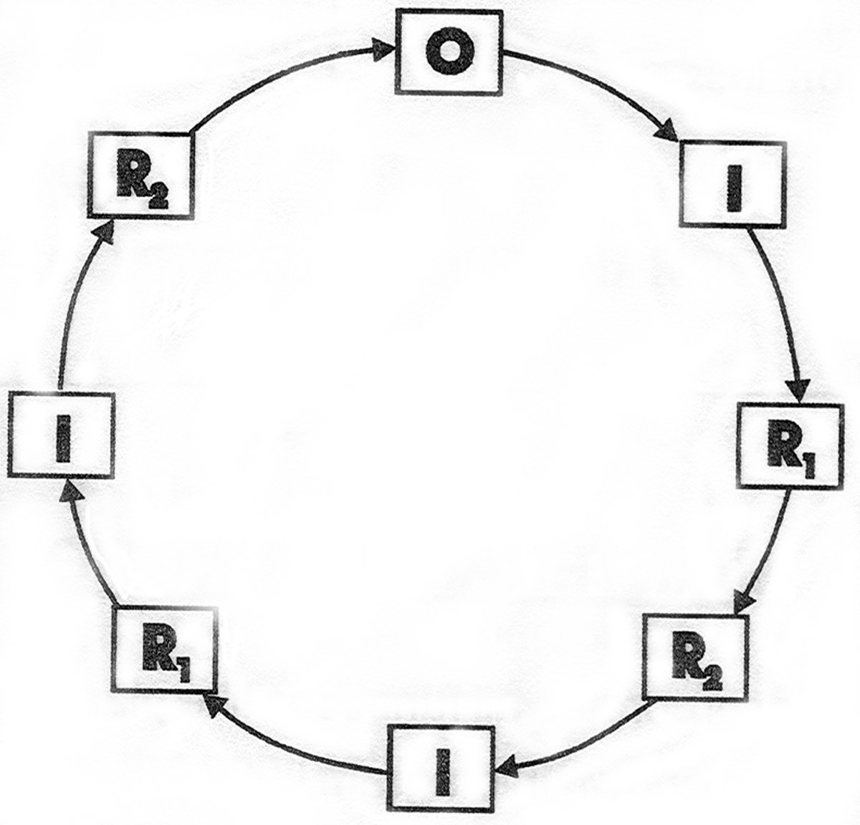
Repair Cycle

Slide 16
The activity is started in a clockwise direction.
It is seen that at first an inspection is scheduled, then a minor and a major is planned.
Once again inspection is done and a minor repair is performed.
After the third inspection a major repairing takes place and then next overhauling comes.
That means completing one repair cycle.
So from the above repair cycle we can state three-Inspections, two-minor & major repair are performed in between the two consecutive overhauling.
Now it is evident that the time period for a repair cycle is dependent on the time intervals between the two activities.
If the time interval is six month, and then the repair cycle is for four years

Slide 17
The planning of time intervals may be considered by the past data of the machine, manufacturing instructions and complexities of the instruments etc

Slide 18
DISPATCHING
Once scheduling is completed, the next phase is dispatching, that is to issue order to start work. So maintenance authority issues “work order”.
ANALYSING
To evaluate the maintenance work done so far, a feed system is followed.
In that system a “Work report” communicates, “What has been done” against our planned work schedule of “What to do” Analyzing of such report will enable the management to control and review the “Maintenance planning”.

Slide 19
CONTROLLING
Whenever the plan deviates or does not occur as per schedule, a corrective measure is to be followed.
For this, monitoring of the total project is carried out which provides information, if any change of action is to be made in course of work
The maintenance work-order and work report may be checked and compared in course of work, whether the work has already been done, or work need is waiting for any spare or is facing any type of administrative of technical difficulties, are always to be monitored.
The both way information line should exist with the superior personnel. If the work has been done satisfactorily, then it is recorded in equipment history card

Slide 20
SAFETY PRECAUTIONS
Exercise extreme care and precaution when working on any printing press.
Observe and practice all safety rules, regulations, and advice given in the press manual.
Head all verbal and written instructions before performing maintenance or operating the press.
Wear protective gear for eyes, ears, head, and feet where necessary to protect against injury.
Stand clear of the press immediately when the run signal is given.
Make sure the press is completely stopped before touching any of its operating parts.
Check all safety devices on the press every day to ensure that they are reliable and working.

Slide 21
Never switch off safety devices or remove or otherwise bypass guards.
Before working on the press, check to make sure it has been put on “safe”
Check that stairs, footrests, running bolts, gangways, plat forms, and other equipment surfaces are clean and free of grease. Do not place tools and supplies on these surfaces.
Grasp handrails securely when ascending the platforms, standing on the platforms, and before leaving the platforms.
Only clean the ink foundations while the press is stopped to avoid injury and press damage.
Do not work on moving rollers with rags, tolls etc., because of the risk of accident and damage.

Slide 22
Reinstall guards immediately after removing the press wash up devices.
Use the “reverse” button on the press only for plate removal-not for cleaning or gumming cylinders, etc.
Do not operate equipment unless authorized.
Check that all guards and shields are in place before operating the press.
Never release a safe button that someone else has set
Do not start a press that has stopped without an apparent reason.
Wear a gearing protection device when working in areas with noise levels.

Slide 23
Check that all guards, covers and swivelling footrests are securely fastened before performing maintenance or operating the press
Check for persons, tools, or equipment between and around the press before starting it.
Remove all used plates, tools, and equipment from the press area and alert your co-workers before starting the press.
Wear a hearing protection device when working in areas with high noise levels.
Do not permit people with jewellery, loose clothing, or long hair in the pressroom.
Do not lean or rest hands on the press.
Do not carry tools in pockets to avoid the possibility of dropping them into the press or other hazardous locations.

Slide 24
When making press adjustments, use only recommended tools that are kept in good working condition.
Keep clear of nips, slitters, and moving parts when performing maintenance or operating the press.
To perform any cleaning process, use rags folded into a pad with no loose edges dangling.
Keep all service manuals, instruction manuals, parts lists, and lubrication manuals in the pressroom.
Never make repairs and adjustments or perform maintenance and cleaning jobs when the machine is running.

Slide 25
HOUSEKEEPING
It is an orderly arrangement of operations, tools equipment, storage facilities and supplies.
It is a practical method of increasing production, reducing accident and improving morale and public relations.

Slide 26
Typical Accidents due to poor House keeping
Men tripping over loose objects on floors, starts, and platforms
Men getting hit by article falling from overhead
Men slipping on greasy wet or dirty floors.
Men running against or projecting, poorly piled or poorly placed materials
Men getting trapped under materials falling from piles improperly built
Men stepping on or tearing hands or other parts of the body on Projecting nails/hooks

Slide 27
Typical Items of Unsafe Housekeeping
Excessive materials, waste, or debris in the work area.
Congested aisles
Overloaded waste containers
Disorderly kept locker and washrooms
Dirty walls, ceiling &windows
Lint and dust on bearing or machines
Tools left on machines
Poor lighting
Acids in open containers
Electric wires, cables and hoses across aisles
Spillage of oil, grease, storage areas etc not properly marked

Slide 28
Aids to good housekeeping
Proper layout of work area
The marking of aisles and storage areas
Cabinets and holders for tools and portable equipment
Storage and arrangements for materials
Efficient sequence of operations to avoid bottlenecks
Efficient transportation of the raw material, the finished product and the refuse
Efficient cleaning methods such as use of vacuum cleaners
Careful training of employees.

Slide 29
THE 5S’s: THE FIVE STEPS OF HOUSEKEEPING
Seiri/Sort: Distinguish between necessary and unnecessary items and discard the unnecessary items.
Seiton/Straighten: Put essential things in order to so that they can be easily accessed.
Seiso/ Scrub: Clean everything-tools and workplaces – removing stains, spots, and debris (Keep machines and working environments clean)
Seiketsu/ Systematize: Extend the concept of cleanliness to oneself and continuously practice the above three steps.
5. Shitsuke/ Standardize: Standardize the previous four steps to make the process one that never ends and can be improved upon.

